Slide 1
Wireless Network
Wireless networks are networks that use radio waves to connect devices , without the necessity of using cables of any kind.
The basis of wireless systems are radio waves, an implementation that takes place at the physical level of network structure.
Radio frequency (RF) is any of the electromagnetic wave frequencies that lie in the range extending from around 3 kHz to 300 GHz
In radio and electronics, an antenna is an electrical device which converts electric power into radio waves, and vice versa.
Notes:
Wireless networks use radio waves to connect devices such as laptops to the Internet, the business network and applications.

Slide 2
Wireless Network
Wireless Network
Radio waves propagate through space as travelling electromagnetic waves. The energy of signals exists in the form of electrical and magnetic fields. Both electrical and magnetic fields vary sinusoidally with time.
The two fields always exist together because a change in electrical field generates a magnetic field and a change in magnetic field develops an electrical field. Thus there is continuous flow of energy from one field to the other.

Slide 3
Wireless Network
Devices commonly used for wireless networking include
Sensor, Embedded controllers, portable computers, desktop computers, hand-held computers, personal digital assistants (PDAs), cellular phones, pen-based computers, and pagers. Wireless networks work similar to wired networks, however, in case of wireless networks, transmitting and receiving data are more challenging.
Notes:
A personal digital assistant (PDA), also known as a handheld PC, is a variety mobile device which functions as a personal information manager. Personal digital assistants were designed to replace non-electronic day planners. Many PDAs can work as an address book, a calculator, a clock, and a calendar. Some also have games on them. Newer PDAs are now called smartphones and have Wi-Fi, touch screens, can read e-mail, record video, play music and make phone calls.
A pager (also known as a beeper or bleeper^{[1]}) is a wireless telecommunications device that receives and displays alphanumeric or voice messages. One-way pagers can only receive messages, while response pagers and two-way pagers can also acknowledge, reply to and originate messages using an internal transmitter.^{[2]}

Slide 4
Devices commonly used for wireless networking
Sensor: A very simple wireless device is represented by a sensor transmitting state information. One example could be a switch sensing the office door. If the door is closed, the switch transmits this to the mobile phone inside the office. Without user interaction, the semantics of a closed door is applied to phone calls.
Embedded controllers: Many appliances already contain a simple or some times more complex controller. Keyboards, mice, headsets, washing machines, coffee machines, hair dryers and TV sets are just some examples.
Pager: As a very simple receiver, a pager can only display short text messages, has a tiny display, and cannot send any messages. Pagers can even be integrated into watches.
One-way pagers can only receive messages, while response pagers and two-way pagers can also acknowledge, reply to and originate messages using an internal transmitter.

Slide 5
Devices commonly used for wireless networking
Personal digital assistant: PDAs typically accompany a user and offer simple versions of office software (calendar, note-pad, mail). The typical input device is a pen, with built-in character recognition translating handwriting into characters. Web browsers and many other software packages are available for these devices.
Pocket computer: The next steps toward full computers are pocket computers offering tiny keyboards, color displays, and simple versions of programs found on desktop computers (text processing, spreadsheets etc.).
Notebook/laptop: Finally, laptops offer more or less the same performance as standard desktop computers; they use the same software – the only technical difference being size, weight, and the ability to run on a battery. If operated mainly via a sensitive display (touch sensitive or electromagnetic), the devices are also known as notepads or tablet PCs.

Slide 6
Why Wireless?
Why do we need a new technology when we have such a developed public telephone network.
Ease of deployment:
Wireless network can be easily installed
No running media cables between Transceivers
Cost
Inexpensive
Ease of use:
Use from anywhere
Allows multiple devices to simultaneously use the same wireless connection
Mobility:
Communicate while moving
Notes:
Wireless infrastructure can be built for very little cost compared to traditional wired alternatives. But building wireless networks is only partly about saving money. By providing people in your local community with cheaper and easier access to information, they will directly benefit from what the Internet has to offer. The time and effort saved by having access to the global network of information translates into wealth on a local scale, as more work can be done in less time and with less effort.
Wireless networks allow remote devices to connect without difficulty, independently these devices are a few feet or several kilometers away.
And no need to break through walls to pass cables or install connectors. This has made the use of this technology very popular, spreading rapidly.

Slide 7
Limitations of Wireless Networks
Attenuation or Signal Loss
The farther they travel, the more wireless signals begin to lose their strength. This equates to attenuation (or weakening signals).
Interference
Multipath fading
When signals are transmitted, they don’t always take a direct path. Instead, they bounce off nearby indoor/outdoor objects and reflect back at different times, which can result in signal deterioration (delayed signals all carrying the same information). Proper steps must be taken to remove those delayed signals.
Reflection Materials
Hidden node problem
Absorption Wireless Networks
Absorption is when the signal strength loses power as it passes through a medium. All materials will absorb the signal at different rates. Wood is an example of a material that can heavily absorb a signal, which can lead to problems

Slide 8
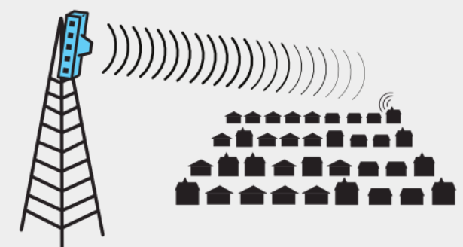
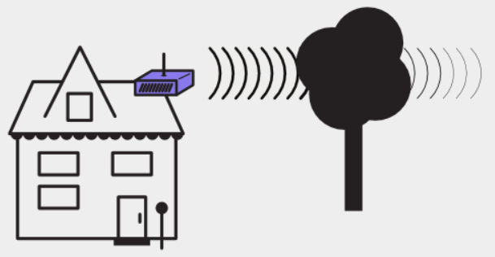
Wireless Challenges that comes up when working with wireless equipment
Each scenario presents a specific challenge or problem that comes up when working with wireless equipment. They are categorized as:
Distance — Wireless signals lose power the further they travel, no matter the type of antenna.
Line of Sight — Wireless signals can encounter total barriers, preventing connections.
Barriers — Wireless signals lose signal strength through solid objects.

Slide 9
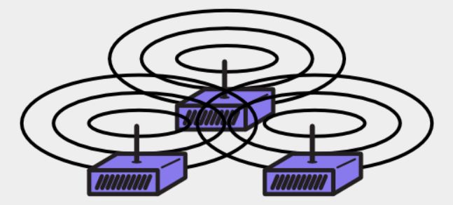
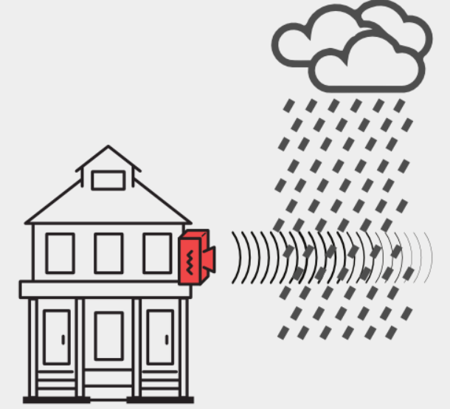
Wireless Challenges?
Wireless Challenges that comes up when working with wireless equipment
Interference — Routers can be too loud, making it impossible for them to hear each other.
Weather — Weather conditions can disrupt wireless signals.
Electrical power issues — Routers need steady electricity to work correctly.

Slide 10
Wireless network taxonomy/ classification
single hop
multiple hops
host connects to
base station (WiFi,
WiMAX, cellular)
which connects to
larger Internet
host may have to
relay through several
wireless nodes to
connect to larger
Internet
infrastructure
(e.g., APs)
no
infrastructure
no base station, no
connection to larger
Internet (Bluetooth,
ad hoc nets)
no base station, no
connection to larger
Internet. May have to
relay to reach other
a given wireless node
MANET(mobile ad hoc network ),
VANET(Vehicular Ad-Hoc Network)
Notes:
A mobile ad hoc network (MANET) is a continuously self-configuring, infrastructure-less network of mobile devices connected wirelessly. Each device in a MANET is free to move independently in any direction, and will therefore change its links to other devices frequently. Each must forward traffic unrelated to its own use, and therefore be a router. The primary challenge in building a MANET is equipping each device to continuously maintain the information required to properly route traffic.
The Vehicular Ad-Hoc Network, or VANET, is a technology that uses moves cars as nodes in a network to create a mobile network. VANET turns every participating car into a wireless router or node, allowing cars approximately 100 to 300 metres of each other to connect and, in turn, create a network with a wide range.

Slide 11
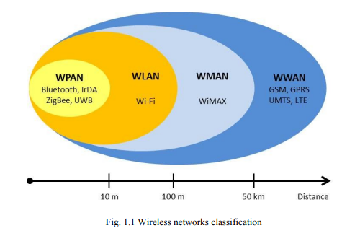
Wireless Network Classification
Wireless networks can be classified into four specific groups according to the area of application and the signal range :
Wireless Personal-Area Networks (WPAN),
Wireless Local-Area Networks (WLANs),
Wireless Metropolitan-Area Networks (WMAN),
and Wireless Wide-Area Networks (WWANs).
Notes:
GPRS - General Packet Radio Service was the evolution of 2G GSM to provide packet switched data at rates up to a maximum of 172 kbps.
GPRS was something of a revolution because all previous mobile phone systems had used circuit switched channels

Slide 12
Wireless Network Classification
Short-range wireless Network:
Local area networks (LANs), such as corporate buildings, school campuses, or homes,
Personal area networks (PANs) where portable computers within close proximity to one another need to communicate.
The above two networks typically operate over unlicensed spectrum reserved for industrial, scientific and medical (ISM) usage. The available frequencies differ from country to country. The most common frequency bands are at 2.4 GHz and at 5 GHz, which are available across most of the globe.
The availability of these frequencies allows users to operate wireless networks without obtaining a license, and without charge.

Slide 13
Wireless Network Classification
long-range wireless networks
In long-range networks, connectivity is typically provided by companies that sell the wireless connectivity as a service.
These networks span large areas such as a metropolitan area (WMAN), a state or province, or an entire country. The goal of long-range networks is to provide wireless coverage globally. The most common long-range network is wireless wide area network (WWAN).
When true global coverage is required, satellite networks are also available.

Slide 14
Bluetooth
Bluetooth corresponds to the IEEE 802.15.1 standard.
Originally Bluetooth was designed for low power consumption, short range and omni-directional (point to multipoint) communications, and cheap devices, to be used as a cable replacement, linking devices through an ad hoc connection of radio waves.
Operates for three different classes of devices: Class 1, class 2 and class 3 where the range is about 100 meters, 10 meters and 1 meter respectively.
Using the 2.4 GHz band, two devices within the coverage range of each other can share up to 720 Kbps of capacity or transfer rate.
The most commonly used is class 2.

Slide 15
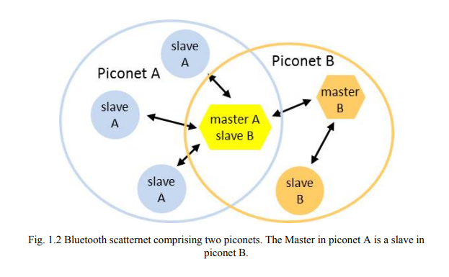
Bluetooth

Slide 16
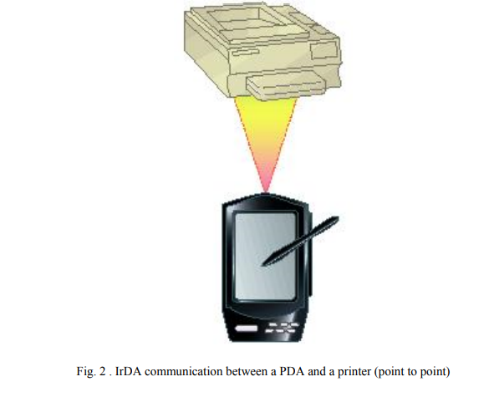
IrDA
The Infrared Data Association (IrDA) specifies a complete set of infrared communications standards.
IrDA is a low-power, low-cost, unidirectional (point to point), narrow angle (< 30º) cone, ad hoc data transmission standard designed to operate over a distance of up to 1 meter and at speeds of 9600 bps to 4 Mbps (currently), 16 Mbps (under development).
Some of the devices that use IrDA are notebooks, PDAs, printers and cameras.
The data transfer takes place between a laptop(computer) and a Mobile when both come into vicinity and line-of-sight of the IR receivers and detectors in each of them.
To Send a document from a notebook computer to a printer.
Notes:
Infrared radiation (IR), sometimes referred to simply as infrared, is a region of the electromagnetic radiation spectrum where wavelengths range from about 700 nanometers (nm) to 1 millimeter (mm).
Ranging from about 300 Ghz to 400 THz.
Application: TV remote sensors and photography.

Slide 17
Zigbee
ZigBee is based on the IEEE 802.15.4 standard
Zigbee is a low-power, low data rate, and close proximity (i.e., personal area) wireless ad hoc network targeted toward automation and remote control applicaions.
The unlicensed bands including 2.4 GHz, at a maximum transfer rate of 250 Kbps. (915 MHz America, or 868 MHz Europe bands). The data rate is 40 kbps at 915 MHz, and 20 kbps at 868 MHz
Typical application areas include:
Home automation
Wireless sensor networks
Industrial control systems
Embedded sensing
Medical data collection
Smoke and intruder warning
Building automation
Remote wireless microphone configuration
Notes:
Zigbee operates in the industrial, scientific and medical (ISM) radio bands: 2.4 GHz in most jurisdictions worldwide. Operate in the unlicensed RF worldwide (2.4 GHz global, 915 MHz America, or 868 MHz Europe) bands. The data rate is 250 kbps at 2.4 GHz, 40 kbps at 915 MHz, and 20 kbps at 868 MHz.
Zigbee is a standards-based wireless technology developed to enable low-cost, low-power wireless machine-to-machine (M2M) and internet of things (IoT) networks. Zigbee is for low-data rate, low-power applications and is an open standard.
Wheel speed sensor

Slide 18
UWB
UWB Based on the IEEE 802.15.3 standard,
Ultra Wide Band (UWB) technology has recently attracted much attention as an indoor short-range(≤10 m) high-speed wireless communications.
A UWB bandwidth is greater than 500 MHz.
UWB enables the movement of massive files at high data rates over short distances.
UWB has a data transfer over 110 Mbps up to 480 Mbps at distances up to few meters which can satisfy most of the multimedia applications such as audio and video delivery in home networking and it can also act as a wireless cable replacement of high speed serial bus such as USB 2.0 and IEEE 1394.
Notes:
The FCC Federal Communications Commission ruling allows UWB communication devices to operate in an unlicensed spectrum from 3.1 to 10.6 GHz. Usually operate at 7.5 GHz band.
The IEEE 802.15.3a has set out to develop a fl exible standard which enables high data rate WPAN (110 Mbps at 10 m, 200 Mbps at 4 m, and 480 Mbps at 2 m)

Slide 19
Wireless Local-Area Network (WLAN)
In WLAN, wireless adapters provide the interface between the network operating system and an antenna to create a transparent connection to the network.
Ethernet is widely used
Wireless LANs can operate in one of two configurations,
With a base station is known as infrastructure-based wireless networks
Without a base station is known as Ad hoc networking .

Slide 20
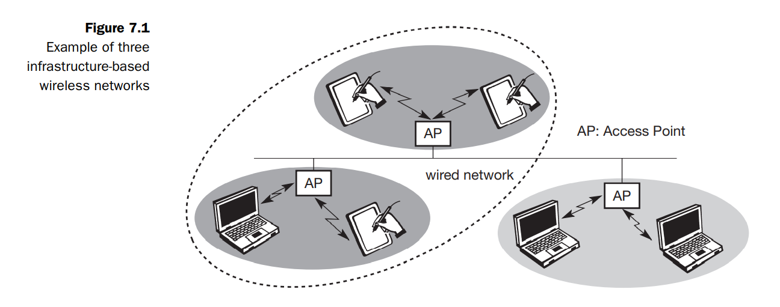
Infrastructure-based wireless networks
The last link with the users is wireless, to give a network connection to all users in a building or campus.
The backbone network usually uses cables
Infrastructure networks not only provide access to other networks, but also include forwarding functions, medium access control etc.
In the infrastructure-based wireless networks, communication typically takes place only between the wireless nodes and the access point, but not directly between the wireless nodes.

Slide 21
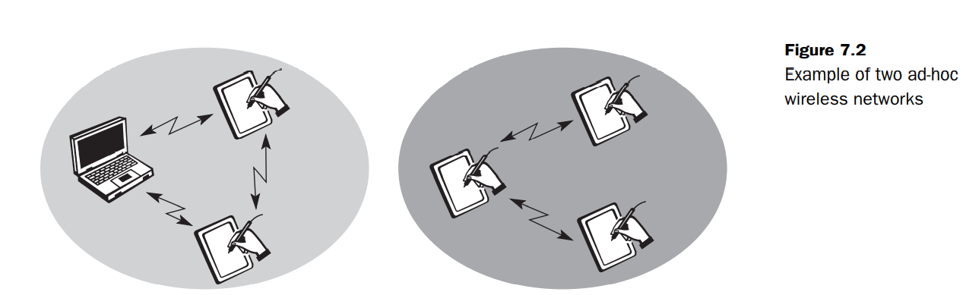
Ad-hoc network.
Each user in the wireless network communicates directly with all others, without a backbone network sometimes called ad-hoc network. This type of network do not need any infrastructure to work. So no access point controlling medium access is necessary.
Figure shows two ad-hoc networks with three nodes each. Nodes within an ad-hoc network can only communicate if they can reach each other physically, i.e., if they are within each other’s radio range.
Nodes from the two networks shown in the figure cannot communicate with each other as they are not within the same radio range.

Slide 22
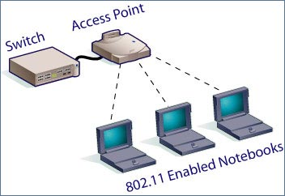
Benefits of Wireless LANs
People can access the network from where they want; they are no longer limited by the length of the cable.
Some cities have started to offer Wireless LANs. This means that people can access the internet even outside their normal work environment, for example when they ride the train.
Setting up a wireless LAN can be done with one box (called Access point). This box can handle a varying number of connections at the same time. Wired networks require cables to be laid. This can be difficult for certain places.
Access points can serve a varying number of computers using DHCP.
Dynamic Host Configuration Protocol (DHCP) is a protocol for assigning dynamic IP addresses to devices on a network. With dynamic addressing, a device can have a different IP address every time it connects to the network
Notes:
Dynamic Host Configuration Protocol (DHCP) is a protocol for assigning dynamic IP addresses to devices on a network. With dynamic addressing, a device can have a different IP address every time it connects to the network
Dynamic Host Configuration Protocol (DHCP) is a client/server protocol that automatically provides an Internet Protocol (IP) host with its IP address and other related configuration information such as the subnet mask and default gateway.
A Subnet mask is a 32-bit number that masks an IP address, and divides the IP address into network address and host address. Subnet Mask is made by setting network bits to all "1"s and setting host bits to all "0"s.

Slide 23
Architecture of the LAN and MAN (WiFi- and WiMAX) integrated network
There may be several RSs (Relay Stations) in the coverage area of one WiMAX BS.
Each RS can establish a communication link with its BS and can serve several MSs in its signal coverage.
In addition, a RS can connect to multiple APs through wirelines (such as Ethernet, Fiber, etc.), that is, this RS serves as the access network of these APs.
A dual-mode MS may connect to an AP or establish a communication link with a RS.
Notes:
AP-Access points
Ethernet is a physical and data link layer technology for local area networks (LANs). Ethernet is a link layer protocol in the TCP/IP stack, describing how networked devices can format data for transmission to other network devices on the same network segment, and how to put that data out on the network connection.
Ethernet cables is limited to roughly 100 meters, but Ethernet networks can be easily extended to link entire schools or office buildings using network bridge devices.

Slide 24
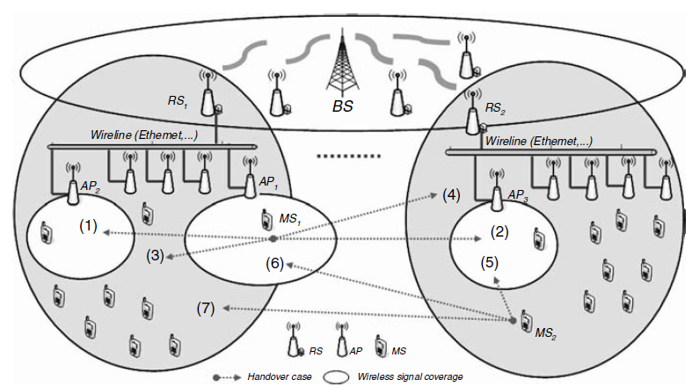
Relay Station (RS)
AP Access Point
Architecture of the LAN and MAN (WiFi- and WiMAX) integrated network

Slide 25
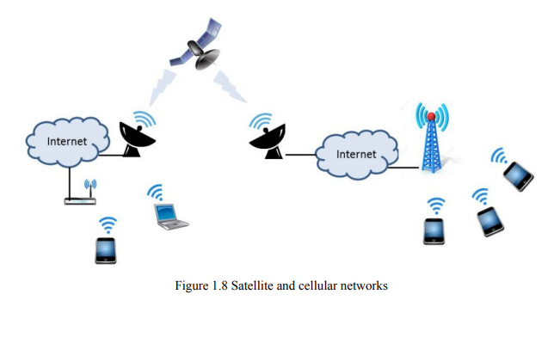
Wireless Wide-Area Network (WWAN)
Satellite Wireless communications can also be developed via satellite.
Due to its high altitude, satellite transmissions can cover a wide area over the surface of the earth.
This can be very useful for users who are located in remote areas or islands where no submarine cables are in service. In these cases, satellite telephones are needed.
Each satellite is equipped with various transponders consisting of a transceiver and an antenna. The incoming signal is amplified and then rebroadcast on a different frequency.
Notes:
Transponder performs the functions of both transmitter and receiver (Responder) in a satellite. Hence, the word ‘Transponder’ is obtained by the combining few letters of two words, Transmitter (Trans) and Responder (ponder).

Slide 26
Infrared LANs
Each signal-covering cell in an infrared LAN is limited to one room. Coverage is small, since the infrared rays cannot penetrate through wall and other opaque obstacles. The primary difference between infrared and radio wireless LANs is the frequency of the transmitted signal. 802.11a and 802.11b operate in the 2.4 and 5GHz bands respectively, but infrared systems use frequencies in the terahertz range.
The use of infrared has several advantages. For example, the bandwidth for infrared communication is large and can therefore achieve high data rates. Also, because infrared rays are reflected by lightly colored objects, it is possible to cover the entire area of the room with reflections from objects. Since infrared cannot penetrate through walls and other opaque obstacles, it becomes very difficult for any adversary to carry out a passive attack or to eavesdrop. Hence, communication with infrared technology is more secure. Also, separate infrared networks can be used in adjacent rooms without any interference effects. Finally, equipment for infrared communication is much cheaper than microwave communication. The one major disadvantage of infrared technology is that background radiation from sunlight and indoor lighting can cause interference at the infrared receivers.
Notes:
Infrared at 1 Mbps and 2Mbps operates at wavelength between 850nm and 950nm.
Infrared signals are placed in the light region invisible to the human eye.
Omnidirectional antenna, an antenna that radiates equally in all directions. omnidirectional
Diffuse mean spread out, or the action of spreading out.

Slide 27
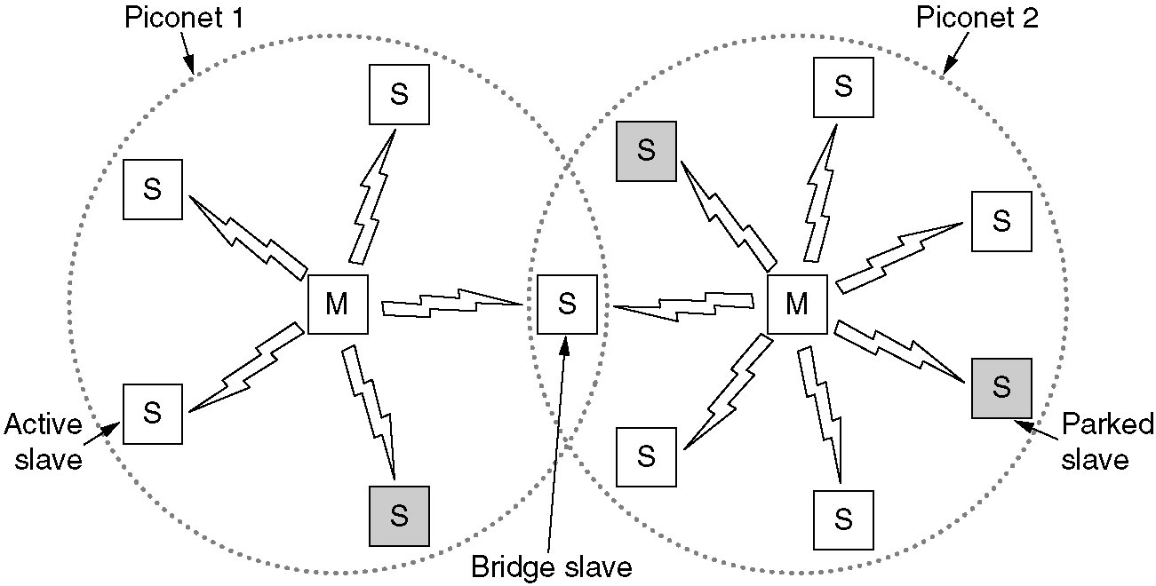
Home RF and Bluetooth
Home RF supports data rates of about 2Mbps and has range of about 50m.
Bluetooth is a wireless LAN technology designed to connect devices of different functions such as telephone, notebooks, computers, cameras, printers etc.
Bluetooth defines two types of networks called: piconet and scatternet.
A piconet can have up to eight stations, one of which is called primary station, the rest are called secondaries. All the secondary stations synchronize their clocks and hopping sequence with the primary. Bluetooth uses frequency-hopping spread spectrum (FHSS) in the physical layer to avoid interference from other devices or network.
Notes:
Piconets have a 7 member address space (3 bits, with zero reserved for broadcast), which limits the maximum size of a piconet to 8 devices, i.e. 1 master and 7 slaves.
A scatternet is a number of interconnected piconets that supports communication between more than 8 devices. Scatternets can be formed when a member of one piconet (either the master or one of the slaves) elects to participate as a slave in a second, separate piconet. The device participating in both piconets can relay data between members of both ad hoc networks. However, the basic Bluetooth protocol does not support this relaying - the host software of each device would need to manage it. Using this approach, it is possible to join together numerous piconets into a large scatternet, and to expand the physical size of the network beyond Bluetooth's limited range.
Currently there are very few actual implementations of scatternets due to limitations of Bluetooth and the MAC address protocol. However, there is a growing body of research being conducted with the goal of developing algorithms to efficiently form scatternets.
A number of companies have attempted to launch social networking and dating services that leverage early scatternet implementations (see Bluedating). Scatternets can also be used to enable ad hoc communication and interaction between autonomous robots and other devices.

Slide 28
Piconets can be combined to form scatternet where a secondary user of one piconet acts as bridge to another piconet. The bridge secondary/slave acts as a primary in receiving packets from the original primary of first piconet then deliver the packet to secondaries of the second piconet.
Although a piconet can have maximum 7 secondaries , additional secondaries can be in parked state. A seconadry in parked state is synchronized with the primary, but can not take part in communication until it is removed from parked state to the active state.
Notes:
Let's say you have a typical modern living room with typical modern stuff inside. There's an entertainment system with a stereo, a DVD player, a satellite TV receiver and a television; there's also a cordless telephone and a personal computer. Each of these systems uses Bluetooth, and each forms its own piconet to talk between the main unit and peripheral.

Slide 29
Wireless Link Characteristics
important differences from wired link ….
decreased signal strength: radio signal attenuates as it propagates through matter (e.g., a radio signal passing through a wall). Even in free space, the signal will disperse, resulting in decreased signal strength (sometimes referred to as path loss) as the distance between sender and receiver increases.
interference from other sources: standardized wireless frequencies (e.g., 2.4 GHz) shared by other devices (e.g., phone); devices (motors, a microwave) interfere as well
multipath propagation: radio signal reflects off objects/ground, reaching destination at slightly different times as it takes paths of different lengths between a sender and receiver. This results in the blurring of the received signal at the receiver. Moving objects between the sender and receiver can cause multipath propagation to change over time.
Bit errors will be more common in wireless links than in wired links which make communication across (even a point to point) wireless link much more “difficult”
Notes:
In wireless telecommunications, multipath is the propagation phenomenon that results
in radio signals reaching the receiving antenna by two or more paths. Causes
of multipath include atmospheric ducting, ionospheric reflection and refraction, and
reflection from water bodies and terrestrial objects such as mountains and buildings.
The effects of multipath include constructive and destructive interference, and phase
shifting of the signal. In digital radio communications (such as GSM) multipath can
cause errors and affect the quality of communications.
Electrical interference: Appliances like air conditioners, heavy motors, x-ray machines and even sometimes hair driers and electric heaters can interfere with the WiFi signal. ... Weather / Environmental Interference: Lightening can disrupt RF signals totally, heavy rain and fog also dampen the signal distance and quality.

Slide 30
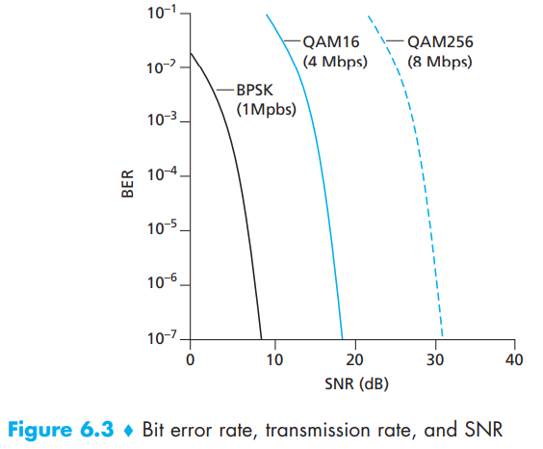
Wireless Link Characteristics: Physical-layer characteristics
Figure shows the bit error rate (BER)—The probability that a transmitted bit is received in error at the receiver—versus the SNR for three different modulation techniques for encoding information for transmission on an idealized wireless channel.

Slide 31
Wireless Link Characteristics: Physical-layer characteristics
For a given modulation scheme, the higher the SNR, the lower the BER. Since a sender can increase the SNR by increasing its transmission power, a sender can decrease the probability that a frame is received in error by increasing its transmission power
There are also disadvantages associated with increasing the transmission power:
More energy must be used by the sender (an important concern for battery-powered mobile users), and the sender’s transmissions are more likely to interfere with the transmissions of another sender.
Notes:
. Note, however, that there is arguably little practical gain in increasing the power beyond a certain threshold,

Slide 32
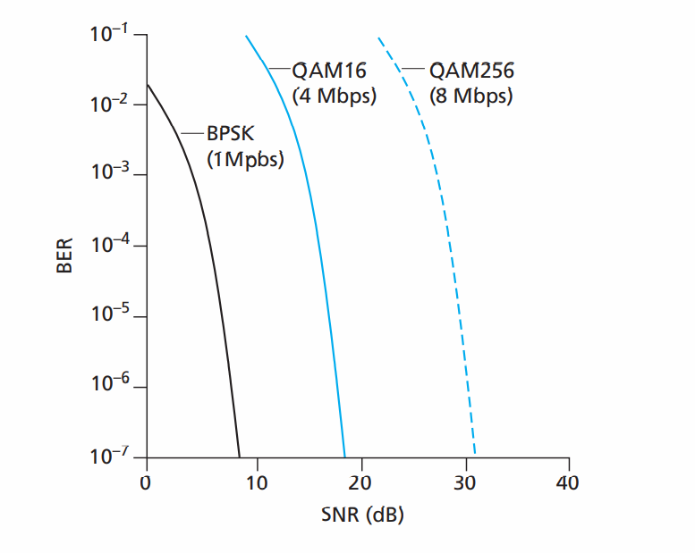

Slide 33
Wireless Link Characteristics: Physical-layer characteristics
For a given SNR, a modulation technique with a higher bit transmission rate (whether in error or not) will have a higher BER. For example, in with an SNR of 10 dB, BPSK modulation with a transmission rate of 1 Mbps has a BER of less than 10⁻⁷, while with QAM16 modulation with a transmission rate of 4 Mbps, the BER is 10⁻¹, far too high. However, with an SNR of 20 dB, QAM16 modulation has a transmission rate of 4 Mbps and a BER of 10⁻⁷, while BPSK modulation has a transmission rate of only 1 Mbps and a BER that is so low as to be (literally) “off the charts.”
Dynamic selection of the physical-layer modulation technique can be used to adapt the modulation technique to channel conditions. The SNR (and hence the BER) may change as a result of mobility or due to changes in the environment. Adaptive modulation and coding are used in cellular data systems and in the 802.11 WiFi and 3G cellular data networks. This allows, for example, the selection of a modulation technique that provides the highest transmission rate possible subject to a constraint on the BER, for given channel characteristics.

Slide 34
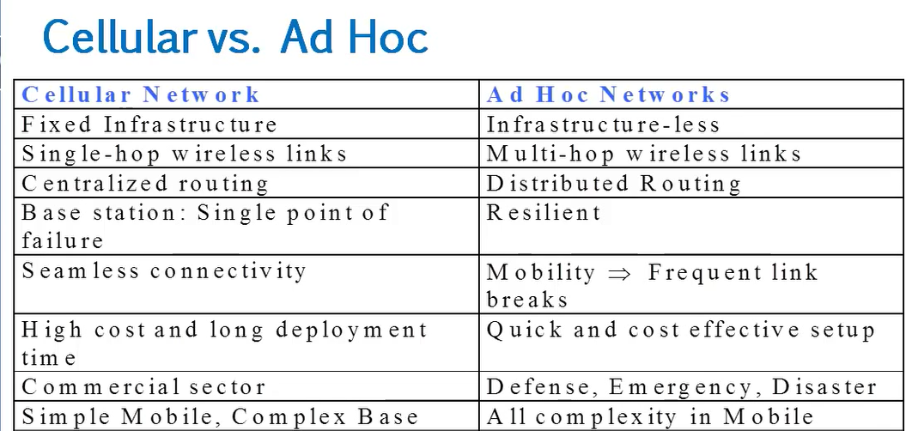

Slide 35
DSDV Packet Process Algorithm
To distinguish state update packets from valid ones, each update packet is tagged by the original node with a sequence number. The sequence number is a monotonically increasing number which uniquely identifies each update packet from a given node.
Consequently, if a node receives an update packet from another node, the sequence number must be equal to or greater than the sequence number already in the routing table
If the new address has a higher sequence number, the node chooses the route with the higher sequence number and discards the old sequence number.
If the incoming sequence number is identical to the one belonging to the existing route, a route with the least cost metric is chosen.

Slide 36
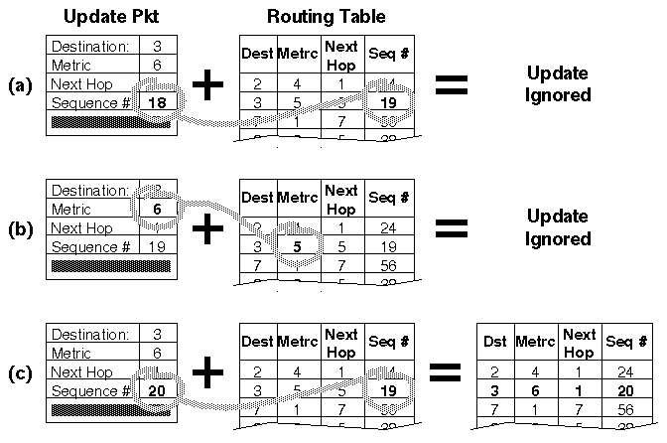
Fig.5 : A node receiving three update packets

Slide 37
The packet overhead of the DSDV protocol increases as the total number of nodes increases in the ad-hoc network. This fact makes DSDV suitable for small networks. In large ad-hoc networks, the mobility rate and therefore the overhead increase, making the network unstable to the point that updated packets might not reach nodes on time.

Slide 38
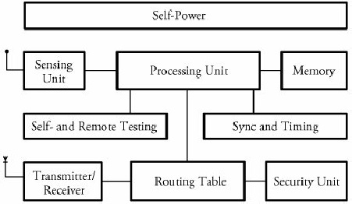
Sensor Node Structure
Figure 3 shows a typical sensor node. A node consists mainly of 3 components: sensing unit, a processing unit and memory, a self-power unit.
Other supporting components are: wireless transceiver component, as well as a self- and remote-testing unit, a synchronizing and timing unit, a routing table, and security units.
Each node must determine its location. This task is carried out by a location-finding system based on the global positioning system (GPS).
Fig.3 A typical wireless sensor node

Slide 39
Sensing Unit
The sensing unit consists of a sensor and an analog-to-digital converter. A smart sensor node consists of a combination of multiple sensors.
The analog signals produced by the sensors, based on the observed event, are converted to digital signals by the converter and then fed into the processing unit.

Slide 40
Processing and Memory Unit
The processing unit performs certain computations on the data and, depending on how it is programmed, may send the resulting information out to the network.
The processing unit, which is generally associated with memory, manages the procedures that make the sensor node collaborate with the other nodes to carry out the assigned sensing task.
The central processor determines what data needs to be analyzed, stored, or compared with the data stored in memory.

Slide 41
LEACH Clustering Protocol
The Low-Energy Adaptive Clustering Hierarchy (LEACH) is an application-specific protocol architecture that aims to prolong network lifetime by periodic re-clustering and change of the network topology.
LEACH is divided into rounds consisting of a clustering phase and a steady-state phase for data collection. At the start of each round, a sensor node randomly chooses a number between 0 and 1 and then compares this number to a calculated threshold called T(n). If T(n) is larger than the chosen number, the node becomes a cluster head for the current round. The value T(n) is calculated using the following formula:

Slide 42
r=0:15;
p=1/16;
Tn =p./(1-p*(mod(r,1/p)));
plot(r,Tn, 'b>-')
xlabel('r')
ylabel('T(n)')
grid on
r = 0 1 2 3 4 5 6 7 8 9 10 11 12 13 14 15
T_{n} = 0.0625 0.0667 0.0714 0.0769 0.0833 0.0909 0.1 0.1111 0.125 0.1429 0.1667 0.2 0.25 0.3333 0.5 1

Slide 43
where p is the ratio of the total number of cluster heads to the total number of nodes, r is the number of rounds, and G is a set of nodes that have not been chosen as cluster heads for the last 1/p rounds.
For the first round (r = 0), T(n) is equal to p, and nodes have an equal chance to become cluster head. As r gets closer to 1/p, T(n) increases, and nodes that have not been selected as cluster head in the last 1/p rounds have more chance to become cluster head.

Slide 44
After 1/p - 1 rounds, T(n) is equal to 1, meaning that all the remaining nodes have been selected as cluster head. Thus, after 1/p rounds, all the nodes have had a chance to become a cluster head once. Since being the cluster head puts a substantial burden on the sensor nodes, this ensures that the network has no overloaded node that runs out of energy sooner than the others.

Slide 45
After cluster heads are self-selected, they start to advertise their candidacy to the other sensor nodes.
When a node receives advertisements from more than one cluster-head, chooses the candidate whose associated signal is received with higher power. This ensures that sensor node chooses the closest candidates as cluster head.

Slide 46
The problem we mentioned here is called Hidden Terminal Problem
A and B can hear each other. B and C can hear each other. But A and C cannot hear each other.
When A is sending data to B, C cannot sense this activity and hence C is allowed to send data to B at the same time. This will cause a collision at B.
collision
A
B
C
Consider the effect of RTS/CTS:
RTS/CTS (Request to Send / Clear to Send) is the optional mechanism used by the 802.11 wireless networking protocol to reduce frame collisions introduced by the hidden node problem.

Slide 47
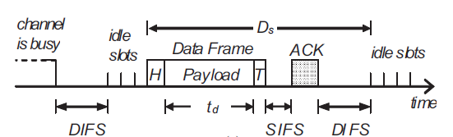
Distributed Binary Exponential Backoff Algorithm
To reduce the packet dropping probability or to enhance throughput of wireless LAN exponential binary backoff algorithm is widely used. The access method of MAC protocol of IEEE 802.11 based on exponential binary backoff algorithm can be explained with the following steps.
Step: 1
The transmitting node first senses the status of the channel. If the channel is found busy then the Tx node continues to monitor the channel.
Step:2
If the channel is found idle for a fixed duration known as DIFS (Distributed Inter-frame Space), the Tx chooses a random number according to the binary exponential back off algorithm. The random number is used as a back off timer.
Notes:
Carrier sense multiple access (CSMA) is a media access control (MAC) protocol in which a node verifies the absence of other traffic before transmitting on a shared transmission medium, such as an electrical bus, or a band of the electromagnetic spectrum.
Although CSMA/CA has been used in a variety of wired communication systems, it is particularly beneficial in a wireless LAN due to a common problem of multiple stations being able to see the Access Point, but not each other. This is due to differences in transmit power, and receive sensitivity, as well as distance, and location with respect to the AP.^{[5]} This will cause a station to not be able to 'hear' another station's broadcast. This is the so-called 'hidden node', or 'hidden station' problem. Devices utilizing 802.11 based standards can enjoy the benefits of collision avoidance (RTS / CTS handshake, also Point coordination function), although they do not do so by default. By default they use a Carrier sensing mechanism called 'exponential backoff', or (Distributed coordination function) that relies upon a station attempting to 'listen' for another station's broadcast before sending. CA, or PCF relies upon the AP (or the 'receiver' for Ad hoc networks) granting a station the exclusive right to transmit for a given period of time after requesting it (Request to Send / Clear to Send).^{[6]}

Slide 48
Step:3
Time immediately after the DIFS (Distributed Inter-frame Space) is slotted known as idle slots where the duration of a slot is considered as the sum of the time required to sense a station and to switch the Tx from sensing / listening mode to transmitting mode.
Step:4
Elapsing of each idle slot the back off timer is decreased by one. If the channel is found busy before the back off timer reaches to zero then repeat the steps 1 to 3. The transmission of data begins only if the back off timer reaches to zero.
Notes:
The essential data that is being carried within a packet or other transmission unit.
First time if the media is free it will only wait for DIFS time, but if it is more than one time or sense busy then it will wait additionally for backoff time.

Slide 49
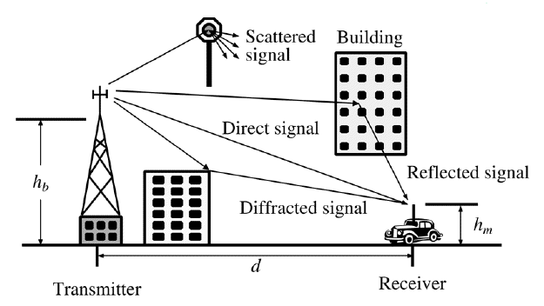
Second Problem:
In radio communication Multipath propagation (Multipath fading) due to presence of reflecting and refracting from water bodies and terrestrial objects such as mountains and buildings or even scatterers hence cause multiple versions of the signal arrive at the receiver through two or more paths.
Multipath propagation causes multipath interference, including constructive and destructive interference of the signal;
Destructive interference causes fading. This may cause a radio signal to become too weak in certain areas to be received adequately, so multipath propagation can be detrimental in radio communication systems.
Notes:
Multipath fading
A direct and Diffracted signal may or may not arrive at the received point in phase. Radio waves that are received in phase reinforce each other and produce a stronger signal at the receiving site, while those that are received out of phase produce a weak or fading signal. Small alterations in the transmission path may change the phase relationship of the two signals, causing periodic fading.
Signals are received in a terrestrial environment, i.e. where reflections are present and signals arrive at the receiver from the transmitter via a variety of paths. The overall signal received is the sum of all the signals appearing at the antenna. Sometimes these will be in phase with the main signal and will add to it, increasing its strength. At other times they will interfere with each other. This will result in the overall signal strength being reduced.

Slide 50
Small-scale fading, or simply fading, is used to describe the rapid fluctuations of the amplitudes, phases, or multipath delays of a radio signal over a short period of time or travel distance, so that large-scale path loss effects may be ignored. With small variation of distance and time cause wide variation of received signal experienced in a dense city.
Fading is caused by interference between two or more versions of the transmitted signal which arrive at the receiver at slightly different times. These waves, called multipath waves, combine at the receiver antenna to give a resultant signal which can vary widely in amplitude and phase, depending on the distribution of the intensity and relative propagation time of the waves and the bandwidth of the transmitted signal.
Notes:
Multipath fading
A direct and Diffracted signal may or may not arrive at the received point in phase. Radio waves that are received in phase reinforce each other and produce a stronger signal at the receiving site, while those that are received out of phase produce a weak or fading signal. Small alterations in the transmission path may change the phase relationship of the two signals, causing periodic fading.
Signals are received in a terrestrial environment, i.e. where reflections are present and signals arrive at the receiver from the transmitter via a variety of paths. The overall signal received is the sum of all the signals appearing at the antenna. Sometimes these will be in phase with the main signal and will add to it, increasing its strength. At other times they will interfere with each other. This will result in the overall signal strength being reduced.

Slide 51
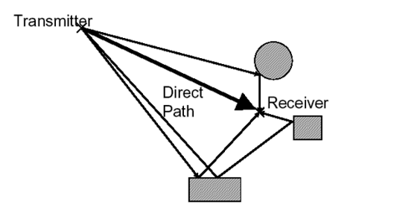
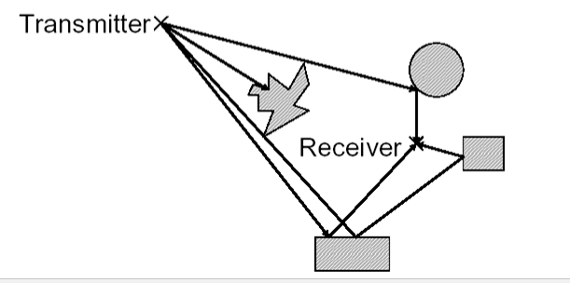
When the magnitudes of the signals are arrived by the various paths have a distribution known as the Rayleigh distribution and the fading is known as Rayleigh fading, where all the components are non-LOS:
i.e. there is no line-of–sight (LOS) component.
When one of the multipath components (a line of sight component) dominates, a Rician distribution provides a more accurate model, and this is known as Rician fading. i.e. there is one LOS component
Rayleigh fading
Rician fading
Notes:
Multipath fading
A direct and Diffracted signal may or may not arrive at the received point in phase. Radio waves that are received in phase reinforce each other and produce a stronger signal at the receiving site, while those that are received out of phase produce a weak or fading signal. Small alterations in the transmission path may change the phase relationship of the two signals, causing periodic fading.
Signals are received in a terrestrial environment, i.e. where reflections are present and signals arrive at the receiver from the transmitter via a variety of paths. The overall signal received is the sum of all the signals appearing at the antenna. Sometimes these will be in phase with the main signal and will add to it, increasing its strength. At other times they will interfere with each other. This will result in the overall signal strength being reduced.

Slide 52
Handoff Region
Third Problem: Handoff is necessary like mobile communications.
A well-implemented handoff is important for delivering uninterrupted service to a caller or data session user
Signal strength due to BS_{i}
Signal strength due to BS_{j}
P_{i}(x)
P_{j}(x)
E
P_{min}
BS_{i}
MS
BS_{j}
X₁
X₃
X₅
X_{th}
X₄
X₂
By looking at the variation of signal strength from either base station it is possible to decide on the optimum area where handoff can take place.
Notes:
A handoff refers to the process of transferring an active call or data session from one cell in a cellular network to another or from one channel in a cell to another.
In Europe and other countries, a handoff is known as a handover.

Slide 53
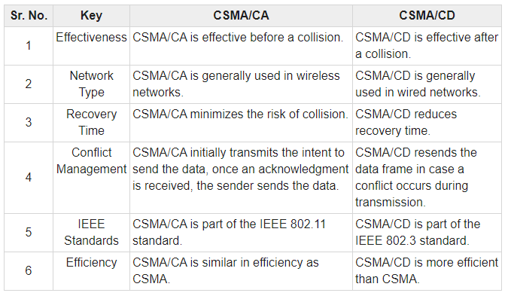
Notes:
intent

Slide 54
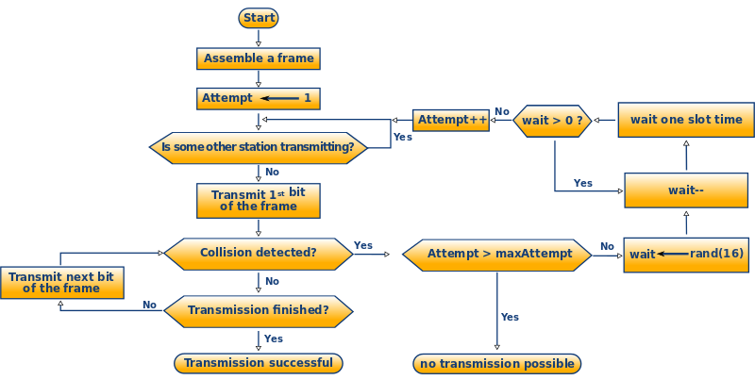
Flow Chart CSMA/CD-Algorithm

Slide 55
Multiple Access Techniques
If data traffic is continuous and a small transmission delay is required (for example in voice communication) reservation based multiple access is used.
the communication channel is based on FDMA, TDMA, or CDMA.
In many wireless systems for voice communication, the control channel is based on random multiple access
The reservation-based multiple access technique has a disadvantage in that once the channel is assigned, it remains idle if the user has nothing to transmit, while other users may have data waiting to be transmitted.
This problem is critical when data generation is random and has a high peak-rate to average-rate ratio.

Slide 56
Multiple Access Techniques
Random multiple access is more efficient, because a communication channel is shared by many users and users transmit their data in a random or partially coordinated fashion. ALOHA and carrier sense multiple access (CSMA) are examples of random multiple access.
If the data arrives in a random manner, and the data length is large, then random multiple access combined with a reservation protocol will perform better than both random- and reservation based schemes.

Slide 57
FDMA
Total system bandwidth is divided into narrow frequency slots.
FDMA assigns individual channels to individual users
A user is free to transmit or receive all the time on its allocated radio channel, but the cost of transceiver is high, as each has to be designed on a different band
Guard bands are maintained between adjacent signal spectra to minimize cross talk between channels
During the period of call no other user can share the same frequency band
Each user transmits with no limitations in time, but using only a portion of the whole available frequency bandwidth.
Different users are separated in the frequency domain
In frequency division duplex (FDD) systems, the users are assigned a channel as a pair of frequencies. One frequency is used for the upward channel, while the other frequency is used for the downward channel

Slide 58
FDMA-advantages
Capacity can be increased by reducing the information bit rate and using an efficient digital speech coding scheme
Technological advances required for implementation are simple. A system can be configured so that improvements in terms of a lower bit rate speech coding could be easily incorporated.
Hardware simplicity, because multiple users are isolated by employing simple bandpass filters.
Notes:
Speech coding is the process for reducing the bit rate of digital speech representation or transmission or storage, while maintaining a speech quality that is
acceptable for the application. Speech coding methods are classified as waveform coding, source coding, and hybrid coding.
The main function of bandpass filter in a transmitter is to limit the bandwidth of the output signal to the band allocated for the transmission. This prevents the transmitter from interfering with other stations.

Slide 59
FDMA-Disadvantages
FDMA wastes bandwidth. If an FDMA channel is not in use, then it sits idle and cannot be used by other users to increase or share capacity.
The FDMA mobile users unit uses duplexers since both the transmitter and receiver operate at the same time. A duplexers add weight, size and cost to a radio transmitter and can limit the minimum size of a subscriber unit
FDMA requires tight RF filtering to minimize adjacent channel interference
Notes:
RF filters are used within transmitters to ensure that unwanted or spurious signals are not transmitted

Slide 60
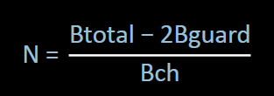
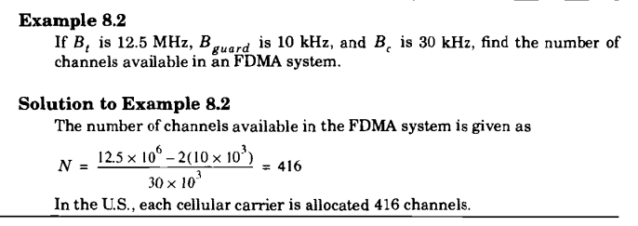
Numbers of Channels in FDMA
Let Btotal be the total system bandwidth, Bguard be the guard band at edge, and Bch the single radio channel bandwidth. Then the number of channels in a FDMA system:
Notes:
Rappaport Example

Slide 61
TDMA
In digital systems, continuous transmission is not required because users do not use the allotted bandwidth all the time. In such cases, TDMA is a complimentary access technique to FDMA.
In TDMA, the entire bandwidth is available to the user but only for a finite period of time. In most cases the available bandwidth is divided into fewer channels compared to FDMA and the users are allotted time slots during which they have the entire channel bandwidth at their disposal.
TDMA requires careful time synchronization since users share the bandwidth in the frequency domain.
The number of channels are less, inter channel interference is almost negligible.
TDMA uses different time slots for transmission and reception. This type of duplexing is referred to as Time division duplexing(TDD).

Slide 62
Example 8.4
If GSM uses a frame structure where each frame consists of 8 time slots, and each time slot contains 156.25 bits, and data is transmitted at 270.833 kbps in the channel, find (a) the time duration of a bit, (b) the time duration of a slot, (c) the time duration of a frame, and (d) how long must a user occupying a single time slot must wait between two simultaneous transmissions.
Solution
The time duration of a bit, Tb = 1/270.833 kbps = 3.692 µs
The time duration of a slot, TSlot= 156.25 x Tb = 0.577 ms.
(c) The time duration of a frame, Tf, = 8 x TSlot = 4.615 ms.
(d) A user has to wait 4.615 ms, the arrival time of a new frame, for its next transmission.

Slide 63
TDMA
Guard times are used between each user’s transmission to minimize cross talk between channels.
In a TDMA/TDD system, half of the time slots in the frame information message would be used for the forward link channels and half would be used for reverse link channels.
In TDMA/FDD systems, the carrier frequencies would be different for the forward and reverse links.
GSM (Global Systems for Mobile communications) uses a TDMA technique, where the carrier is 200 kHz wide and supports eight full rate channels.
A channel (roughly) consists of the recurrence every 4.6 ms of a time slot of 0.58 ms.

Slide 64
Features of TDMA
TDMA shares a single carrier frequency with several users where each users makes use of non overlapping time slots.
The number of time slots per frame depends on several factors such as modulation technique, available bandwidth etc.
Data transmission in TDMA is not continuous but occurs in bursts. This results in low battery consumption since the subscriber transmitter can be turned OFF when not in use. Because of a discontinuous transmission in TDMA the handoff process is much simpler for a subscriber unit, since it is able to listen to other base stations during idle time slots.
TDMA uses different time slots for transmission and reception thus duplexers are not required.
TDMA can be easily adapted to the transmission of data as well as voice communication.
TDMA has an advantage that is possible to allocate different numbers of time slots per frame to different users. Thus bandwidth can be supplied on demand to different users by concatenating or reassigning time slot based on priority.
Notes:
A burst is a transmission involving a large amount of data sent in a short time

Slide 65
Features of TDMA
Permits flexible rates (i.e. several slots can be assigned to a user, for example, each time interval translates 32Kbps, a user is assigned two 64 Kbps slots per frame).
Can withstand variable bit rate traffic. Number of slots allocated to a user can be changed frame by frame (for example, two slots in the frame 1, three slots in the frame 2, one slot in the frame 3, …etc.).
No guard band required for the wideband system.
No narrowband filter required for the wideband system.

Slide 66
Disadvantages
For mobiles and particularly for hand-sets, TDMA on the uplink demands high peak power in transmit mode, that shortens battery life.
TDMA requires a substantial amount of signal processing for matched filtering and correlation detection for synchronizing with a time slot.
TDMA requires synchronization. If the time slot synchronization is lost, the channels may collide with each other.
One complicating feature in a TDMA system is that the propagation time for a signal from a mobile station to a base station varies with its distance to the base station.

Slide 67
Number of channels in TDMA system
The number of TDMA channel slots that can be provided in a TDMA system is found by multiplying the number of TDMA slots per channel by the number of channels available and is given by
N = m(BTot — 2Bguard)/Bc
where m is the maximum number of TDMA users supported on each radio channel. Note that two guard bands, one at the low end of the allocated frequency band and one at the high end, are required to ensure that users at the edge of the band do not "bleed over" into an adjacent radio service.
Notes:
bleed over-contamination

Slide 68
Number of channels in TDMA system
Example 8.3
Consider Global System for Mobile, which is a TDMA/FDD system that uses 25 MHz for the forward link, which is broken into radio channels of 200 kHz. If speech channels are supported on a single radio channel, and if no guard band is assumed, find the number of simultaneous users that can be accommodated in GSM.
Solution
The number of simultaneous users that can be accommodated in GSM is given as
N =8*25MHz/(200 kHz)
=1000
Thus, GSM can accommodate 1000 simultaneous users.
Notes:
Rappaport Example

Slide 69
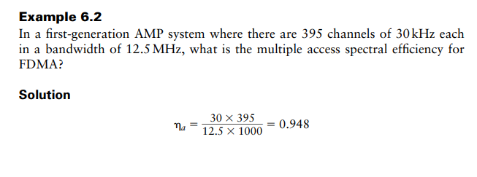
Multiple Access Spectral Efficiency

Slide 70
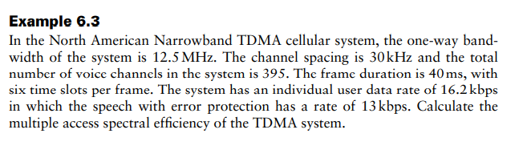
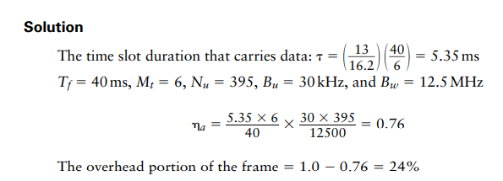

Slide 71
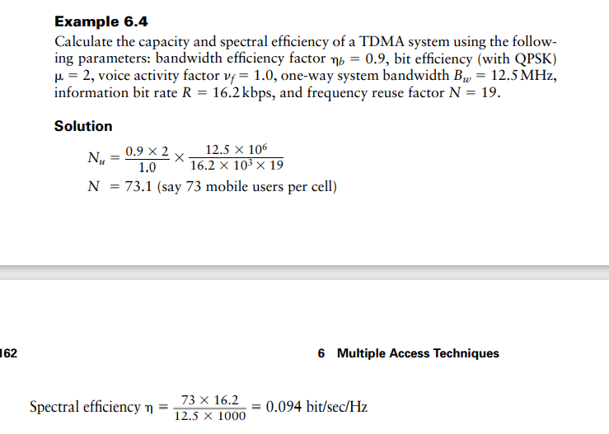

Slide 72
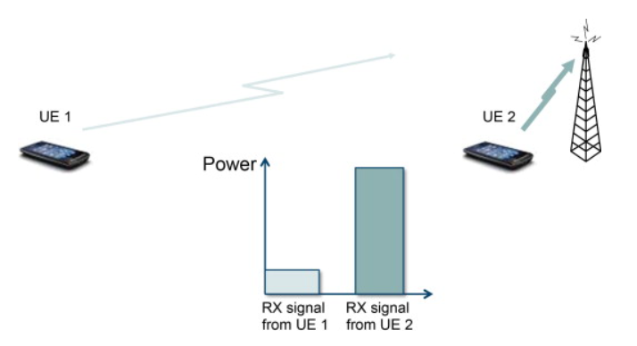
Problem
A problem can arise when the signals from different users are received at very different power levels, for example, because in the uplink one user is close to the base station whereas a second user is not, as shown in Figure.
Stronger received signal levels raise the noise floor at the base station for the weaker signals, thereby decreasing the probability that weaker signals will be received.
In this case, the spreading gain will not be able to suppress the interference from the (strong) second user’s transmission sufficiently and the reception of the first user will experience a poor signal-to-interference ratio because of interference from the second user. This problem is known as the “near-far” problem and is mitigated by the use of power control that keeps the receive power from different transmissions at appropriate levels (depending on the users’ relative data rates). Power control is provided by each base station in a cellular system and assures that each mobile within the base station coverage area provides the same signal level to the base station receiver.
Notes:
The Noise Floor is the signal created from adding up all the unwanted signals within a measurement system. The noise floor consists of noise from a number of sources which includes thermal noise, atmospheric noise and noise from components used to make the measurement system.

Slide 73
Direct Sequence Multiple Access(DSMA)
CDMA is a Direct Sequence Spread Spectrum system. The CDMA system works directly on 64 kbit/sec digital signals.
In CDMA, each bit time is subdivided into m short intervals called chips. Typically there are 64 or 128 chips per bit. Each station is assigned a unique m-bit chip sequence.
To transmit a 1 bit, a station sends its chip sequence.
To transmit a 0 bit, it sends the one's complement of its chip sequence.
No other patterns are permitted.
Thus for m = 8, if station A is assigned the chip sequence 00011011, it sends a 1 bit by sending 00011011 and a 0 bit by sending 11100100.

Slide 74
Direct Sequence Multiple Access(DSMA)
Increasing the amount of information to be sent from b bits/sec to mb chips/sec can only be done if the bandwidth available is increased by a factor of m, making CDMA a form of spread spectrum communication.
In order to protect the signal, the chip sequence code used is pseudo-random. It appears random, but is actually deterministic, so that the receiver can reconstruct the code for synchronous detection. This pseudo-random code is also called pseudo-noise (PN).

Slide 75
Frequency Hopped Multiple Access (FHMA)
Frequency hopped multiple access (FHMA) is a digital multiple access system in which the carrier frequencies of the individual users are varied in a pseudorandom fashion within a wideband channel.
The digital data is broken into uniform sized bursts which are transmitted on different carrier frequencies.
The instantaneous bandwidth of any one transmission burst is much smaller than the total spread bandwidth.
The pseudorandom change of the carrier frequencies of the user randomizes the occupancy of a specific channel at any given time, thereby allowing for multiple access over a wide range of frequencies.
In the FH receiver, a locally generated PN code is used to synchronize the receivers instantaneous frequency with that of the transmitter.

Slide 76
Frequency Hopped Multiple Access (FHMA)
Types of frequency hopping are:
(I) Slow frequency hopping
(2) Fast frequency hopping
Slow-frequency hopping- In slow frequency hoping several symbols are transmitted corresponding to each frequency hopping. Therefore each frequency hopping several symbols i.e. frequency hopping takes place slowly.
Fast frequency hopping- In the fast frequency hopping during the transmission of one symbol, the carrier frequency will hop several times. Therefore each symbol transmission several frequencies hops. Thus- the frequency hopping takes place at a fast rate.

Slide 77
PN Sequences
PN sequences are periodic but appear random within one period
PN sequences are very easy to generate
Generated using LFSR
PN sequences are easy to re-generate and synchronize at the receiver
PN sequences have good random properties
linear-feedback shift register - LFSR

Slide 78
Linear-feedback shift register
A linear-feedback shift register (LFSR) is a shift register whose input bit is a linear function of its previous state.
The most commonly used linear function of single bits is exclusive-or (XOR). Thus, an LFSR is most often a shift register whose input bit is driven by the XOR of some bits of the overall shift register value.
The initial value of the LFSR is called the seed, and because the operation of the register is deterministic, the stream of values produced by the register is completely determined by its current (or previous) state. Likewise, because the register has a finite number of possible states, it must eventually enter a repeating cycle. However, an LFSR with a well-chosen feedback function can produce a sequence of bits that appears random and has a very long cycle.

Slide 79
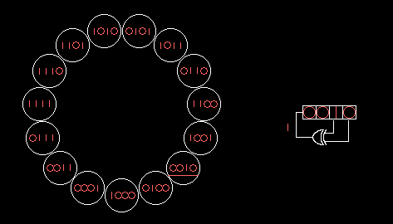
Linear-feedback shift register
A 4-bit Fibonacci LFSR with its state diagram. The XOR gate provides feedback to the register that shifts bits from left to right.

Slide 80
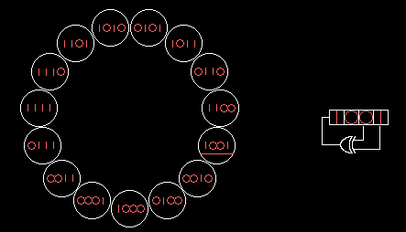
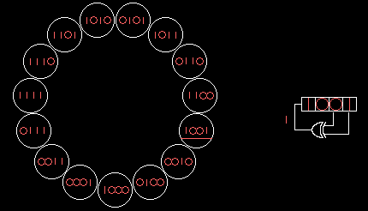
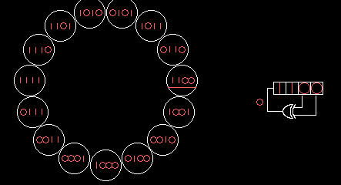
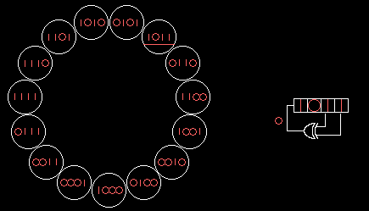
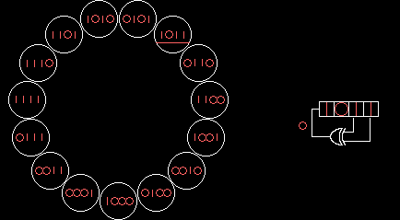
Linear-feedback shift register
A 4-bit Fibonacci LFSR with its state diagram. The XOR gate provides feedback to the register that shifts bits from left to right.

Slide 81
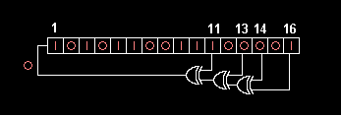
Linear-feedback shift register
16-bit Fibonacci LFSR

Slide 82
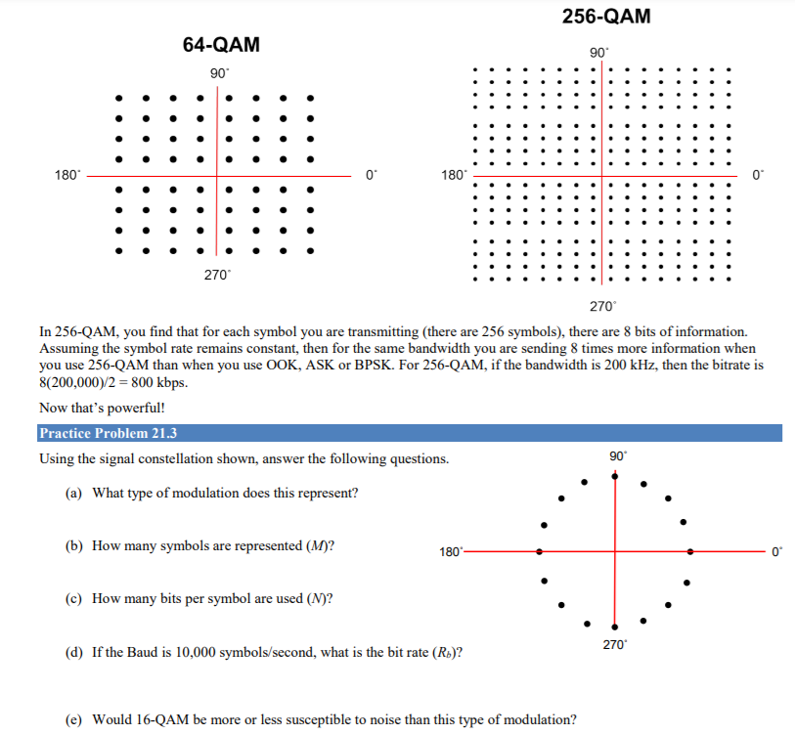
Notes:
Some modulation methods are more immune to noise than others. Amplitude modulation methods like ASK/OOK and QAM are far more susceptible to noise so they have a higher BER for a given modulation. Phase and frequency modulation (BPSK, FSK, etc.) fare better in a noisy environment so they require less signal power for a given noise level

Slide 83
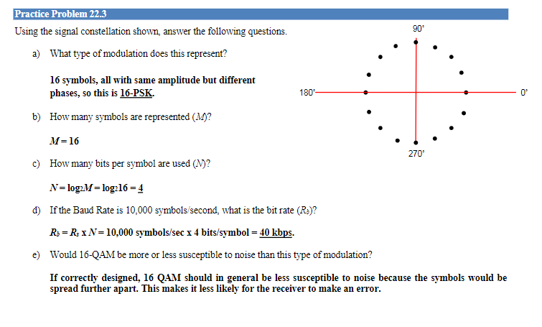
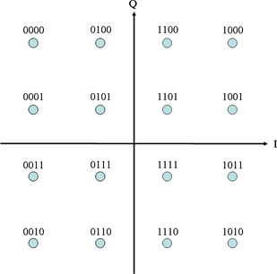

Slide 84
If the bandwidth for 8-QAM and 8-PSK is BW=2Rb/3, then i) what is the bandwidth of 16-QAM and 16-PSK? ii) If a bit stream of 64 kb/s is to be transmitted, how much bandwidth is required in each case?
iii) How many symbols are represented (M) for 8-QAM and 16- QAM modulation?
iv) How many bits per symbol are used (K) for 8-PSK and 16-PSK?
v) If the Baud is 10000 symbols/s, what is bit rate (Rb) for 8-QAM and 16-QAM?
v) Draw the signal constellation diagram for both 16-QAM and 16-PSK.

Slide 85
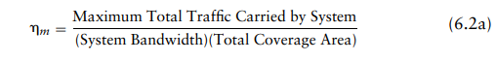
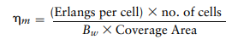
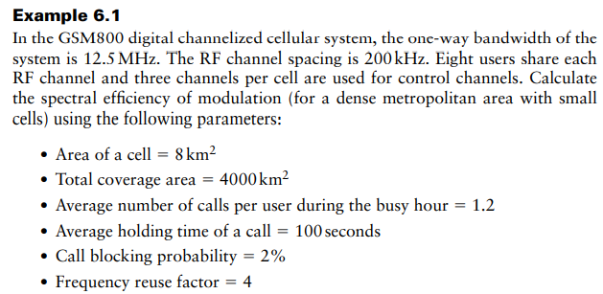
Spectral Efficiency of Modulation

Slide 86
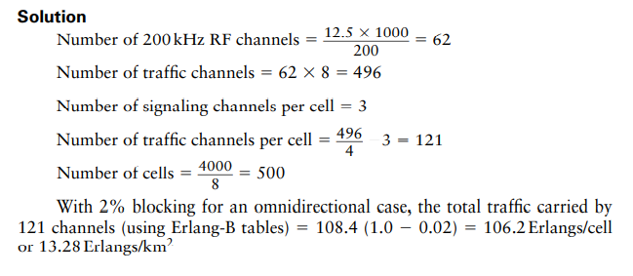
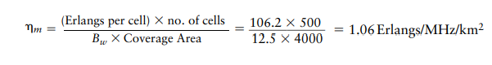

Slide 87
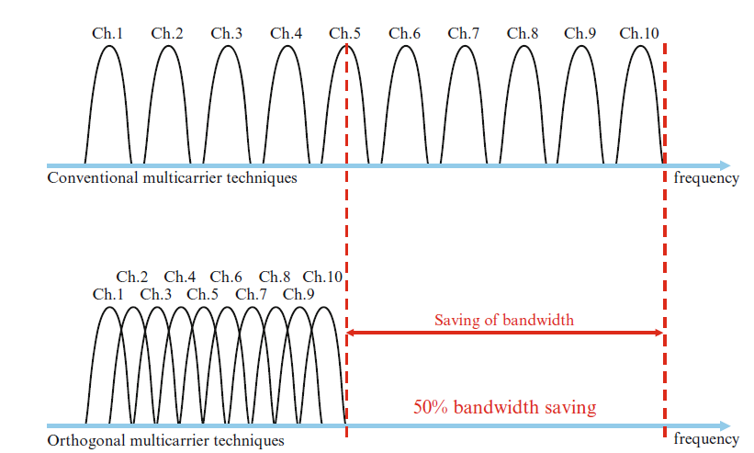
OFDM Versus FDM
The essential property of the OFDM signal is the orthogonality between the subcarriers.
The use of orthogonal subcarriers allows more subcarriers per bandwidth resulting in an increase in spectral efficiency.
In a perfect OFDM signal, Orthogonality prevents interference between overlapping carriers.
In FDM systems, any overlap in the spectrums of adjacent signals will result in interference. In OFDM systems, the subcarriers will interfere with each other only if there is a loss of orthogonality.
Notes:
Each OFDM subcarrier is 312.5 KHz, Subcarrier spacing is equal to the reciprocal of the symbol time. As a result of the longer symbol time, the subcarrier size and spacing decreases from 312.5 KHz to 78.125 KHz. The narrow subcarrier spacing allows better equalization and therefore enhanced channel robustness. Because of the 78.125 KHz spacing, an OFDMA 20 MHz channel consists of a total of 256 subcarriers
The guard interval, containing cyclic prefix may be shortened from 0.8μs to 0.4μs, thus increasing actual data rate to 72.25Mbps, or 150Mbps in 40MHz
The simplest meaning of orthogonal is “at right angles”. A broader definition is that things are independent from each other, or separable.
How is this separation done? Using a Fourier Transform, usually in the form of an FFT (Fast…). This allows us to have a number of very tightly spaced carriers, but we still can recover the modulation from each carrier. The limit on how tight the carriers can be spaced is the rate of modulation; if the modulation is 15 kHz, the carrier spacing has to be 15 kHz (note that it’s not “at least 15 kHz”, it’s exactly 15 kHz).

Slide 88
A baseband OFDM transmission model
x₀(t)
Σ
S/P
x₁(t)
x(t)
Channel
………
x_{Nc-1}(t)
f_{q}=q∆f
r(t)
Fig.3
f_{k}=k∆f
A baseband OFDM transmission model is shown in Figure 3. It basically consists of a transmitter (modulator, multiplexer and transmitter), the wireless channel, and a receiver (demodulator).

Slide 89
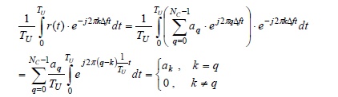
A baseband OFDM transmission model
x_{q} is the received subcarrier and x_{k} represents the local oscillator.
When integrating received power over one symbol period, T_{U}, the output of the correlators is zero for any combination, except when k = q.

Slide 90
Why Hexagonal Cell?
Hexagonal-shaped communication cells are artificial and that such a shape cannot be generated in the real world. Engineers draw hexagonal-shaped cells on a layout to simplify the planning and design of a cellular system because it approaches a circular shape that is the ideal power coverage area. The circular shapes have overlapped areas which make the drawing unclear. The hexagonal shaped cells fit the planned area nicely with no gap and on overlap between the cells. The real cell has irregular shape because of natural, and man made obstacle in service area.
R
R
R
Cell
R
R
(a) Ideal cell
(b) Actual cell
(c) Different cell models
Factitious

Slide 91
Frequency Reuse Distance
The minimum distance which allows the same frequency to be reused is called Frequency Reuse Distance. It depends on many factors such as the number of co-channel cells in the vicinity of the center cell, the type of geographic land outline, antenna height and the transmitted power at each cell site.

Slide 92
Frequency Reuse Distance
R
Cluster
For hexagonal cells, the reuse distance is given by
F7
F2
F6
F1
F3
F1
where R is cell radius and N is the reuse pattern (the cluster size or the number of cells per cluster).
F5
F4
F7
F2
F3
Reuse ratio is
F6
F1
F1
Reuse distance D
F5
F4

Slide 93
Determine two parameters i and j, called shift parameters
Starting from any cell, move i cells along any one of the six emanating chains of hexagons. Turn clock (or counter clock)-wise by 60 degree and then move j cells along the chain. The destination is the nearest co-channel cell
By repeating this pattern, clusters of cells are formed such that each cell within a cluster is assigned a different set of frequencies. Such a cluster is called a frequency reuse pattern.

Slide 94
Example-1
7 cell reuse cluster
where
Reuse factor
i = 2, j = 1
Note: i and j are integers
=7

Slide 95
Example-2
19 cell reuse cluster
A
A
A
A
A
A
A
Shift Parameter: i = 3, j = 2
= 19

Slide 96
If all the cell sites transmit the same power then N increases and the frequency reuse distance D increases. This increased D reduces the chance that the co-channel interference may occur. Theoretically a large N is desired. However the total number of allocate channel is fixed. When N is too large, the number of channel assigned to each of N cells becomes small and carried traffic of that cell will be smaller.
Exam date: 18/08/2023 file 7 8 9 upto 55

Slide 97
Co-channel Interference
Co-channel interference ratio is given by
where I is co-channel interference and M is the maximum number of co-channel interfering cells. We know,
C α R^{-γ}
Therefore C=K. R^{-γ;} where K is a constant and γ is path loss slope,
γ = 2~5, Similarly, I_{k} = K. D_{k}^{-γ}
For M = 6, C/I is given by,
C
1
=
I
⎛
−γ
M
D
⎞
∑
⎜
⎟
k
⎝
R
⎠
k
=
1

Slide 98
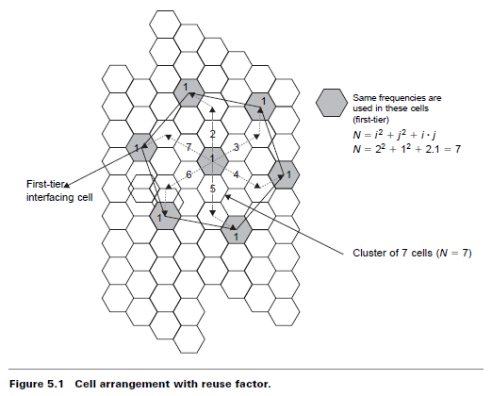
Cellular Systems
Book -(Vijay Garg)

Slide 99
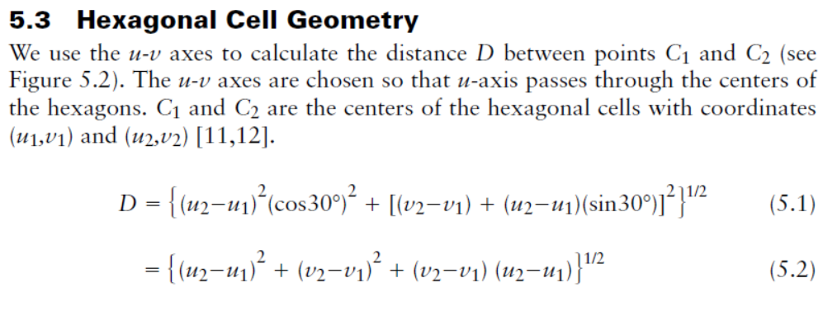


Slide 100



Slide 101


Slide 102

N =7

Slide 103


(Book Vijay Garg)

Slide 104


Slide 105


Slide 106


Slide 107


